Slide 1
Solution Design Patterns from real-life projects
Scope of this presentation: This presentation aims at elaborating solution design patterns I had come across on real-life projects while building IT solutions.

Slide 2
1. Building losely coupled solution enabling re-usable components
Losely coupled solutions are softwares that may interact but are not dependant on each other.
This enables solutions built using different incompatible technologies to be joined for transactions.

Slide 3
2. Building a generic platform that can be customized to various clients
Building a generic platform that acts as a base enables a product based organization to attract new clients.
A generic platform can be easily customized to specific requirements of an end client.

Slide 4
3. Building solutions that are scalable across devices
Building solutions that are easily scalable across various devices helps from re-writing code from scratch
Avoiding code re-write saves a lot of time and cost for the project and organization.

Slide 5
4. UX screens designed alongside mappings to fields in backend database tables
Mapping fields in the backend while working out fields displayed on screens help design screens that are practical to build and NOT superficial.
This helps manage client expectations and uncover any problems early

Slide 6
5. Staging tables while migrating data from legacy systems
Staging tables helps better tidied up data before making it's way to the integrated database.
Staging tables helps uncover data problems early in migration phases.

Slide 7
6. Single Sign-On
Enables users to sign-on once and access various applications without having to sign-on to several applications separately.
Enables maintenance of better identity and profile.

Slide 8
7. Support model to include how to support on day 1 and months later of go-live
Support model for go-live to include specifics and checks required on day-1 and months later as the solution is better stabilized months after go-live as apposed to day-1.

Slide 9
8. Strategic Operating Model followed by Target Operating Model
Strategic Operating Model followed by Target Operating Model helps organization to adapt strategically to change before fully transforming the day to day functioning towards Target Operating Model.
This helps a phased approach to business change and transformation initiatives.

Slide 10
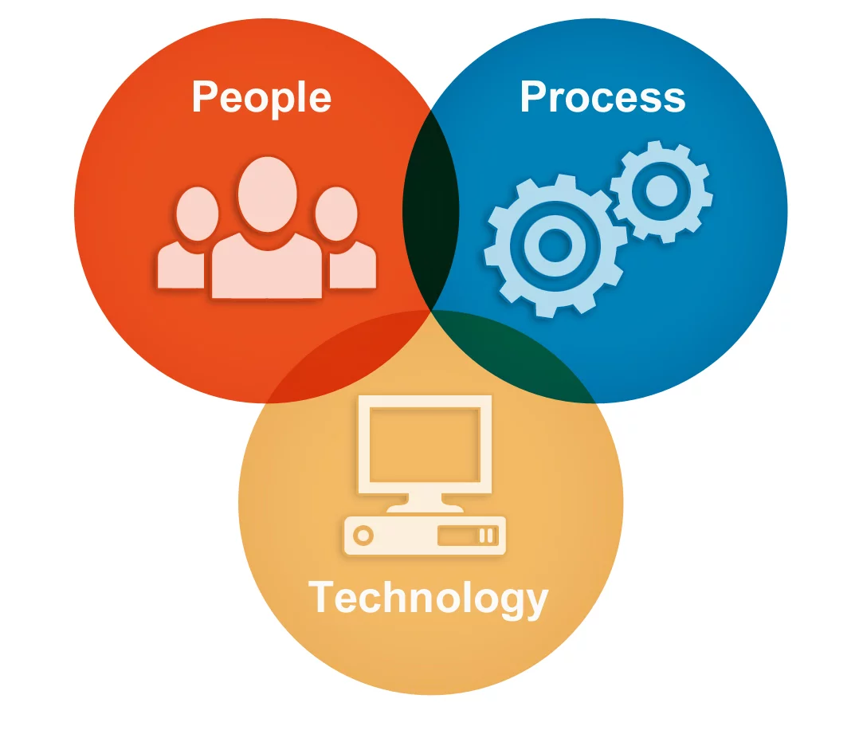
9. People, Process & Technology together during Operational Design
People process and technology to be taken in to account together while modelling business processes simplifies the business processes saving cost and time to the organization

Slide 11
10. Detailed release notes including any patches for every release to test
Detailed release notes including any patches helps keep both the business and technology streams in the project fully informed.
This as well helps teams working across geographies with time differences in working hours.

Slide 12
11. Paperless office
Aiming electronic correspondences and secure messaging as much as enables paperless office saving cost and time to the organization.
Electronic paperless would mean users receive the correspondences instantly.

Slide 13
12. Procurement inline with organizations strategy across projects
Applying a set of parameters inline with an organization's strategy helps achieve better consistency across projects.
Helps easier maintenance after go-live.

Slide 14
13. Feedback from Management Information (MI) input to requirements phase
Pain points in user journeys are usually fed in to MI. Keeping awareness of MI while gathering new requirements enables better quality of requirements.

